Slide 1
Sentiment Analysis of Movie Reviews: Using Machine Learning
Nishan Karki
The main aim of this project is to explore the movie reviews dataset and discuss some interesting observations through visualizations and train machine learning models to analyze the sentiment of movie reviews using supervised learning.

Slide 2
Background
Movies are good for entertainment purpose as well as they reflect the life of people. A good movie which has a good message can change the society and influence people’s lives.
However, not every movie is good and carry important messages. Some movies are not worth people’s important time.
One of the ways to know about movie is by getting the reviews from people who have already watched it. However, there may be bias if the sample size is too small due to varying people’s opinion. So, a good way to judge is by collecting the large sample and getting the average.

Slide 3
Motivation
I have been watching movies since I was a small kid. Not only I have been watching movies for entertainment, but also for life lesson, motivation, and exposure to different culture. There has been times where I have watched bad movies many times with no good story line or content. I wish I had known early so that I would not have watched it.
Sentiment relates to the meaning of a word or sequence of words and is usually associated with an opinion or emotion.
Sentiment analysis of many reviews posted by people helps us to determine the attitude of critics depending on their reviews and can rate how positive or negative a movie review is as well as the overall rating for a movie. Therefore, the process of understanding if a review is positive or negative can be automated as the machine learns through training and testing the data.
This project aims to rate reviews using many classifiers and compare which gives better and more accurate results. Classification is a data mining methodology that assigns classes to a collection of data in order to help in more accurate predictions and analysis. Many classification algorithms like Naïve Bayes, Logistic Regression, Decision tree, and Random Forest will be used, and the results of sentiment analysis compared.

Slide 4
Movie Reviews Dataset
Downloaded from Kaggle provide by Lakshmipathi N.
Link to the dataset: https://www.kaggle.com/lakshmi25npathi/imdb-dataset-of-50k-movie-reviews
Size of dataset: 50k movie reviews

Slide 5
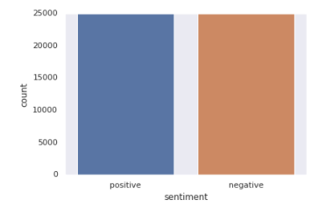
Loading the dataset
Loading the dataset into google colab using pandas.
The number of positive and negative reviews is equal, i.e. 25000. Since, the dataset is balanced, there is no need of any data transformation.

Slide 6
Overview of Sentiment Analysis
Steps Involved In Sentiment Analysis of Movie Reviews
Data Cleaning
Data Pre-processing
Modeling Algorithms for Classification
Model Performance Evaluation
Hyperparameter Tuning and Evaluation
Model Deployment
Future Improvements

Slide 7
Data Cleaning
It involves removing emojis, links, double spacing, punctuations, digits, non ascii characters from tweets.
Lower-casing the reviews.

Slide 8
Data Pre-Processing
Remove English Stop Words from Reviews
Lemmatization of Reviews
Creating the bag of words from the whole corpus of cleaned reviews

Slide 9
1. Removing Stop words
Reviews with stop words | Reviews without stop words
in five days I have not once any movie. I watched this movie it sucks. | days movie watched sucks
coronavirus is killing people and affecting economy. And, we are busy watching this boring movie at home. Movie sucks | coronavirus killing people affecting economy busy watching boring movie home movie sucks
This is an amazing movie. I loved watching this movie with my family. Good content and amazing acting by Ryan Renolds. I love all of Ryan’s movies. He acts pretty good in all movies. | amazing movie loved watching movie family good content amazing acting ryan renolds love ryan movies acts pretty good movies

Slide 10
2. Lemmatization
Reviews after removing stop words | Reviews after performing lemmatization
days movie watched sucks | day movie watch suck
coronavirus killing people affecting economy busy watching boring movie home life sucks | coronavirus kill people affect economy busy watch bore movie home life suck
amazing movie loved watching movie family good content amazing acting ryan renolds love ryan movies acts pretty good movies | amaze movie love watch family good content amaze act ryan renold love ryan movie act pretty good movie

Slide 11
3. Creating the bag of words
The length of the vocabulary list is equal to the length of the vector that will be output when we apply bag of words. For each word in the reviews, we transform the word into a frequency count in the form of a vector.
We perform fit_transform method on CountVectorizer which will construct the vocabulary of the bag-of-words model and transform the sample sentence below into a sparse feature vector.
We can see how vocabularies are now stored in a Python dictionary with each unique word mapped to unique integer indices and the array displays the term frequency for each unique word.
Cleaned review:
amaze movie love watch family good content amaze act ryan renold love ryan movie act pretty good movie
Unique words:
“amaze”, “movie”, “love”, “watch”, “family”, “good”, “content”, “act”, “ryan”, “renold”, “pretty”
Bag of words dictionary:
{“amaze”: 2, “movie”: 3, “love”: 2, “watch”: 1, “family”: 1, “good”: 2, “content”: 1, “act”: 2, “ryan”: 2, “renold”: 1, “pretty”: 1}
[2, 3, 2, 1, 1, 2, 1, 2, 2, 1, 1]

Slide 12
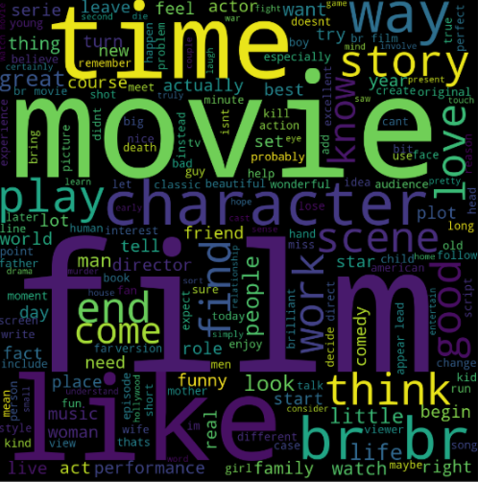
Words for Positive Sentiment

Slide 13
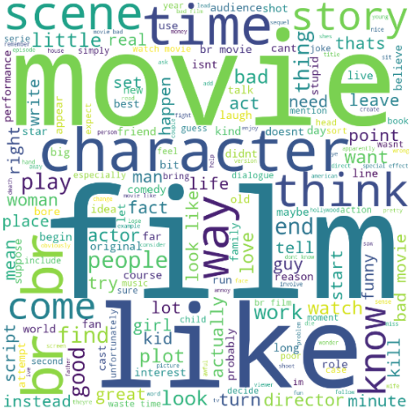
Words for Negative Sentiment

Slide 14
Modeling
Splitting dataset:
Training: 80%
Testing : 20%
Algorithms used:
Naïve Bayes
Random Forest
XGBoost
Logistic Regression

Slide 15
Model Evaluation
Evaluation Metrics: Accuracy (Because the dataset is balanced)
Algorithms | Accuracy
Naïve Bayes | 82.57%
Random Forest | 82.83%
XGBoost | 78.95%
Logistic Regression | 86.35%

Slide 16
Hyper Parameter Tuning
Logistic Regression outperformed all other algorithms and hyper parameter tuning of Logistic Regression increased the accuracy from 86.35 to 87.43.

Slide 17
Model Deployment
Using tuned logistic regression model along with flask web framework and deploying a web application into Heroku.
The deployment link is:
https://sentiment-prediction-app.herokuapp.com/

Slide 18
Future Improvements
Collecting more data from different sources for robust model.
Using Tf-Idf and Word2Vec for transforming word representations to numerical versions.
Creating a more interactive web app with additional features like, uploading dataset, automatic data cleaning, and predicting sentiment features.

Slide 19
References
Lakshmi Devi B., Varaswathi Bai V., Ramasubbareddy S., Govinda K. (2020) Sentiment Analysis on Movie Reviews. In: Venkata Krishna P., Obaidat M. (eds) Emerging Research in Data Engineering Systems and Computer Communications. Advances in Intelligent Systems and Computing, vol 1054. Springer, Singapore. https://doi.org/10.1007/978-981-15-0135-7_31
“Sentiment Analysis with Machine Learning: Process &amp; Tutorial.” MonkeyLearn Blog, 20 Apr. 2020, monkeylearn.com/blog/sentiment-analysis-machine-learning/.

